Slide 1
PIP-102: UNIVERSITY PROJECT-II (PROJECT) Review-1 Presentation Healthcare Chatbot powered by Artificial Intelligence
Submitted to the Presidency University, Bengaluru in partial fulfillment of the requirements for the PIP-102: PROFESSIONAL PRACTICE-II (PROJECT)
By
Batch No: 80
Under the supervision of
Sapna R Assistant Professor Department of Computer Science & Engineering April , 2022
Student Details
Name | MOHAMMED FURQAN AHMED | MOHAMED FAHAD IDREES | MOHAMMED ABDUL WAHAB AHMED | NALLAGARI UDAY KUMAR REDDY | N VASEEM BASHA
Roll No | 20181CSE0430 | 20181CSE0422 | 20181CSE0425 | 20181CSE0464 | 20181CSE0458
Section | 8CSE7 | 8CSE7 | 8CSE7 | 8CSE7 | 8CSE7
Batch No | 80 | 80 | 80 | 80 | 80
1

Slide 2
CHATBOT (a.k.a. chatter bot)
A chatbot is a type of software that can help customers by automating conversations and interact with them through messaging platforms.
The term "ChatterBot" was originally coined by Michael Mauldin (creator of the first Verbot) in 1994 to describe these conversational programs.
There are two basic types of chatbot models;
Retrieval based (Rule based) A retrieval-based chatbot uses predefined input patterns and responses. It is widely used in the industry to make goal-oriented chatbots.
Generative based (Self Learning) Here, chatbots are trained to learn and generate new dialogue depending on the situation. Although the domain is unrestricted, it may sound repetitive and cannot promote stable human conversation.

Slide 3
ABSTRACT
A chatbot for interacting with users as the first layer of communication.
Virtual assistants can help doctors and sometime even patients with a host skilled with medical-related tasks.
The chatbot will be trained to recognize the symptoms and provide diagnosis based on that particular symptom.
It can also determine the severity of the disease based on the symptoms.

Slide 4
LITERATURE SURVEY
Chatbot for Healthcare System Using Artificial Intelligence
Lekha Athota Bachelor of Science Information Technology Amity University Dubai, UAE lekhaA@amitydubai.ae
Vinod Kumar Shukla Department of Engineering and Architecture Amity University Dubai, UAE vshukla@amityuniversity.ae
Nitin Pandey Amity Institute of Information Technology Amity University Noida, UP, India npandey@amity.edu
Ajay Rana AIIT Amity University Uttar Pradesh, Noida, India ajay_rana@amity.edu

Slide 5
OBJECTIVES
To provide healthcare via prevention, diagnosis or cure of disease, illness, injury to patients.
Government agencies can use them in health care field especially for poor people as it is easy to scale up and is inexpensive.
Hospitals and healthcare professionals can use them to save time and money, making doctor appointments convenient.
Our area of focus would be around building a healthcare chatbot to improve the overall system.

Slide 6
EXISTING METHODS (DRAWBACKS)
Seeking doctor appointments and visiting the qualified medical practitioner is very time-consuming process
Late responses as the queue times are long
Diagnosis results are delayed due to complex operations

Slide 7
PROPOSED METHOD
Instant access to a knowledgeable medical assistant
Quick responses with no waiting times
Self diagnosis with severity checker

Slide 8
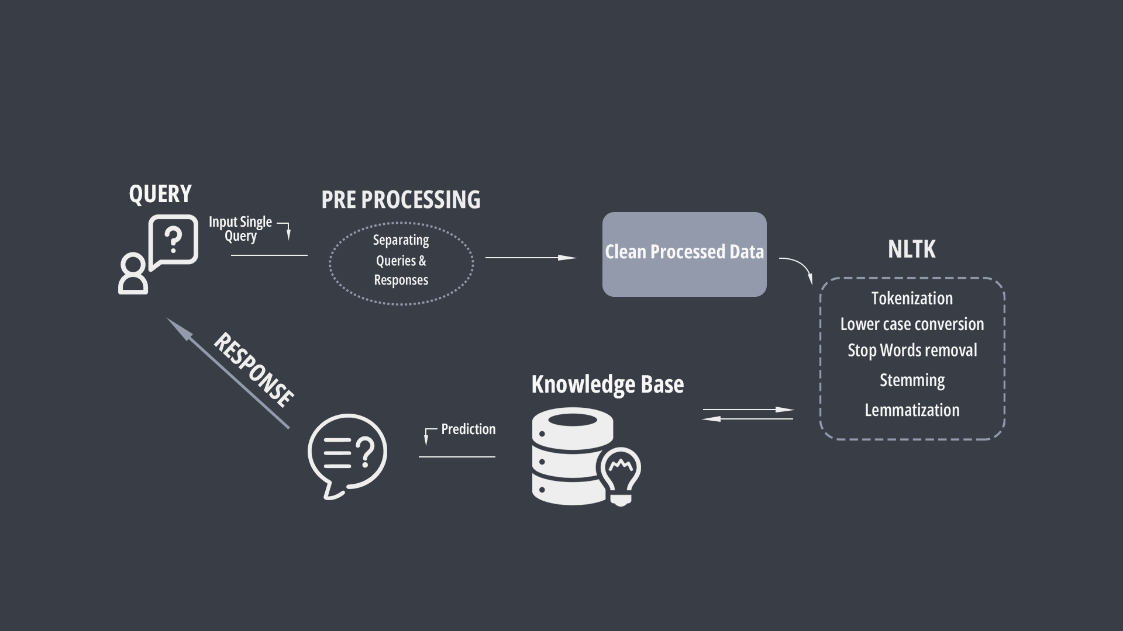
ARCHITECTURE DIAGRAM

Slide 9
References
Wiki https://en.wikipedia.org/wiki/Chatbot https://en.wikipedia.org/wiki/Health_care
Papers https://www.researchgate.net/publication/344983576_Chatbot_for_Healthcare_System_Using_Artificial_Intelligence

